Slide 1
Effect of Numerical Dispersion as a Source of Structural Noise in the Calibration of a Highly Parameterized Saltwater Intrusion Model
Christian D. Langevin and Joseph D. Hughes
Presented at the 2009 PEST Conference, Bethesda, MD

Slide 2
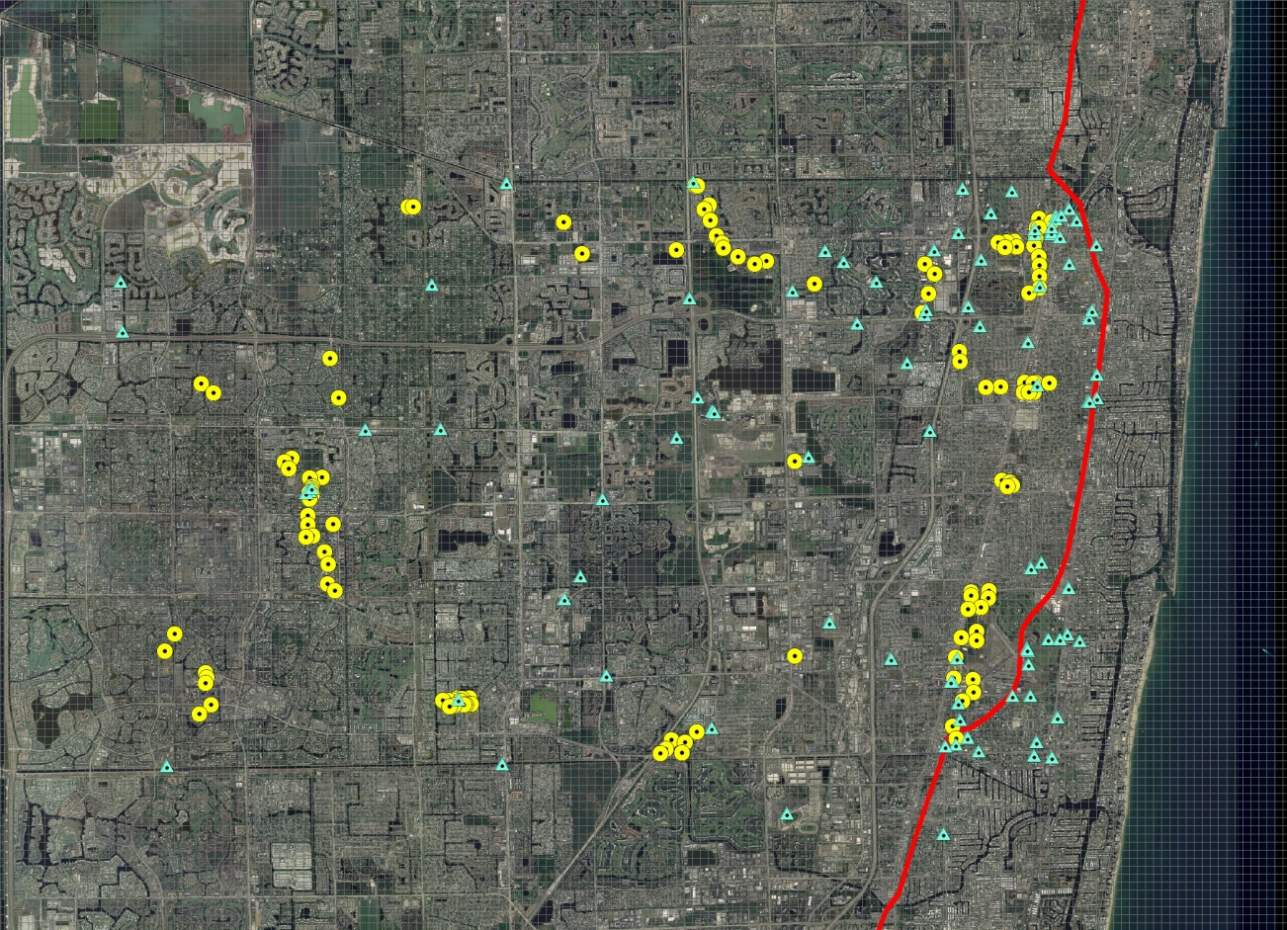
Motivation for this Study
Historic evaluation of saltwater intrusion at a municipal well field

Slide 3
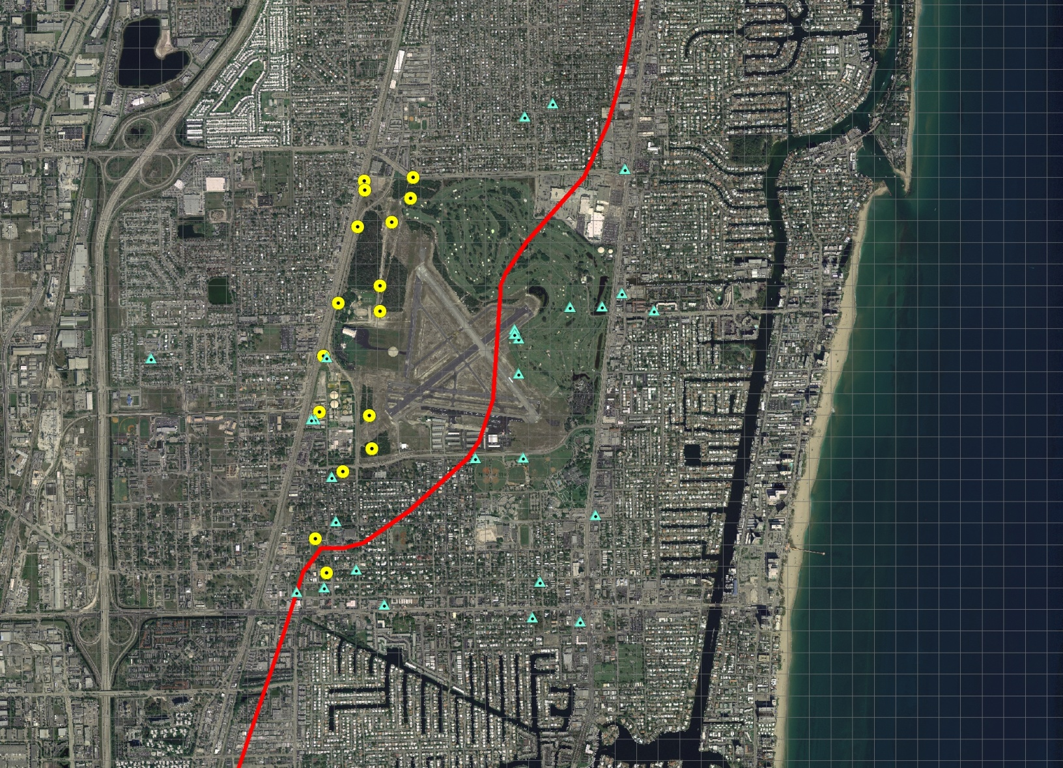
Pompano Beach Well Field

Slide 4
Estimated K Field

Slide 5
Transport Solution Schemes

Slide 6
Weighting Schemes
Uniform weighting
Weights proportional to observation value (e.g. 5% error in concentration values)

Slide 7
Simple 1D Transport Example
A
B
C
100 cells
Homogeneous
K = 1 m/d
α_{L} = 1 x 10⁻⁵ m
n = 0.20

Slide 8
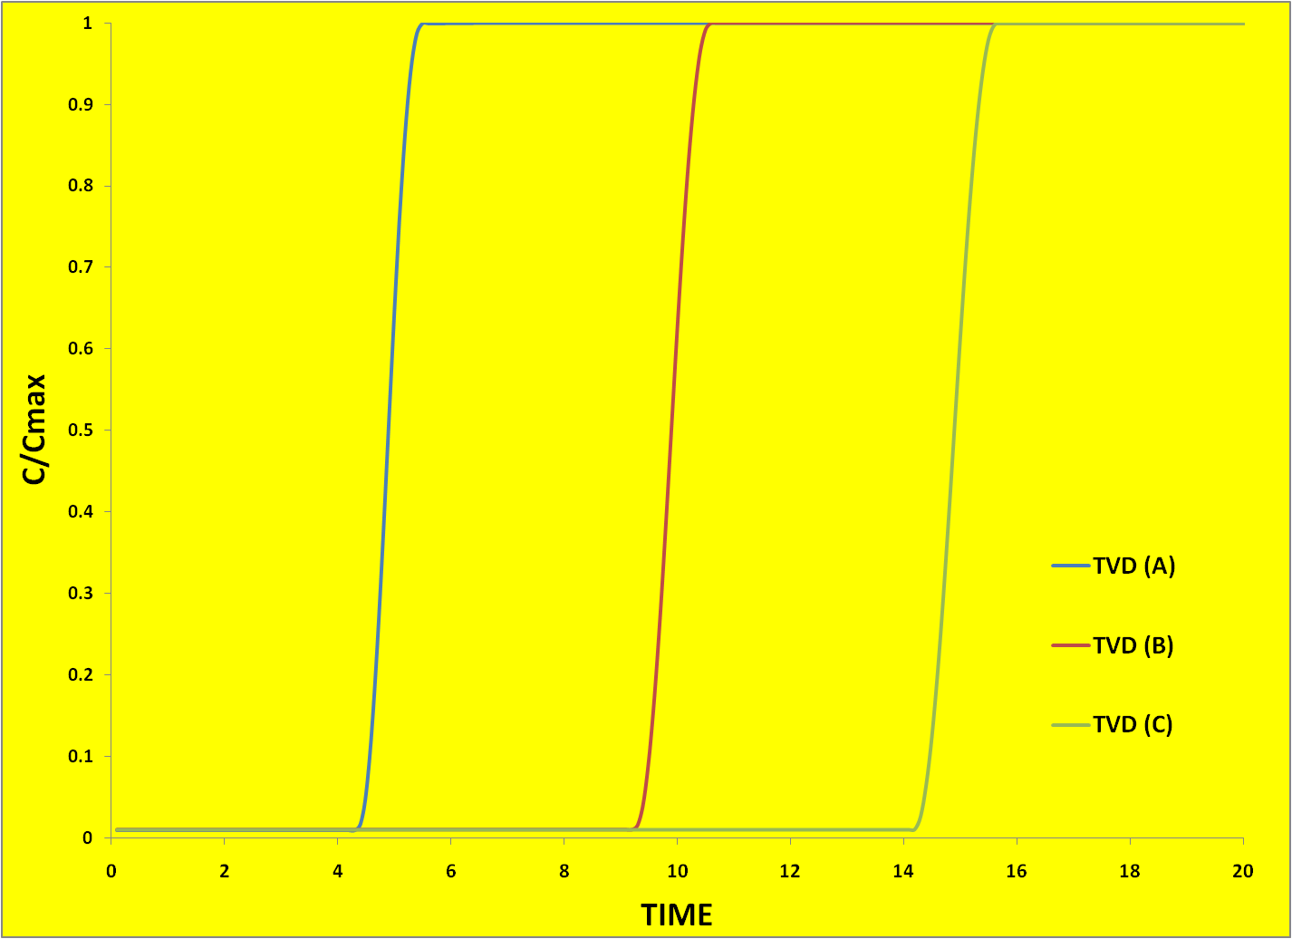
1D Results (TVD)

Slide 9
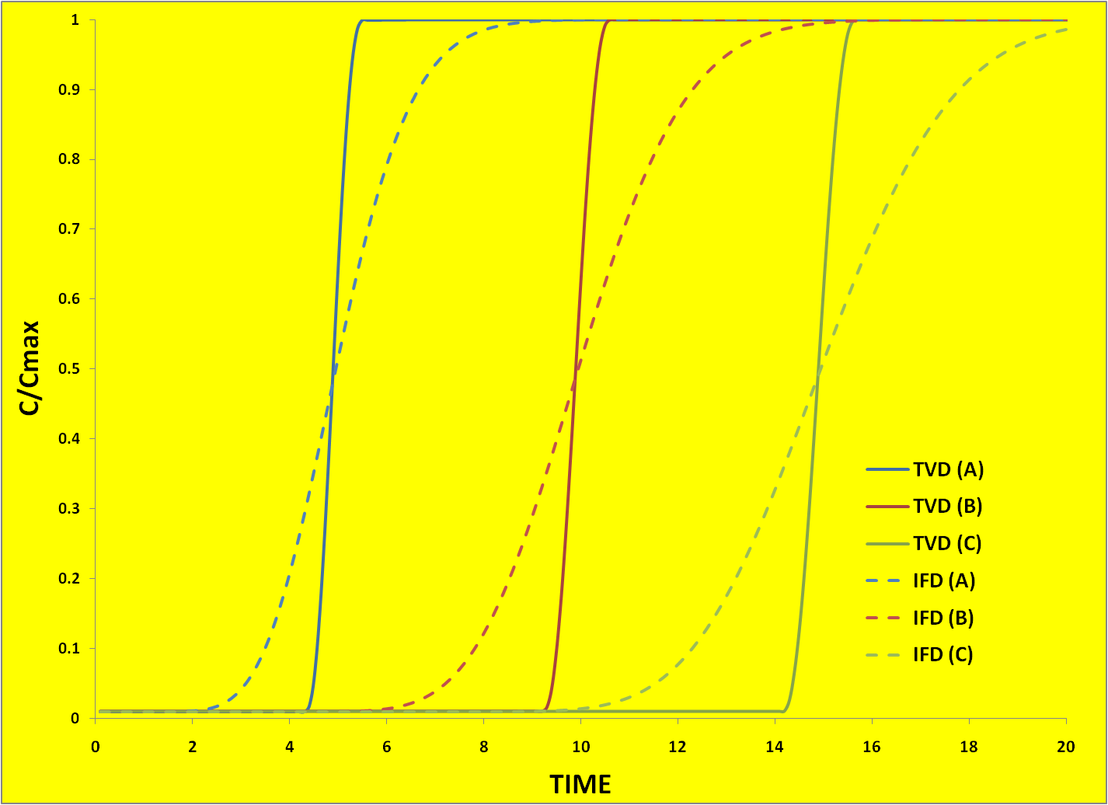
1D Results (TVD and IFD)

Slide 10
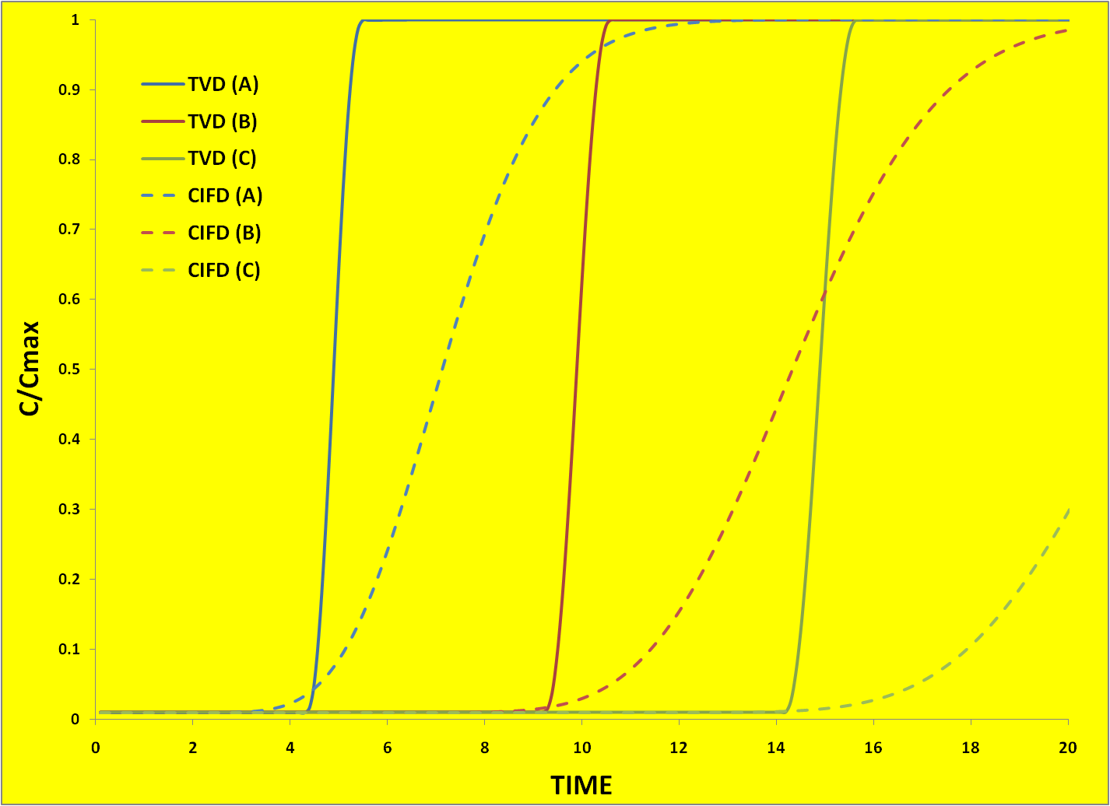
1D Results (TVD and CIFD)
K = 0.7 m/d

Slide 11
Finding
For a 1D transport problem, estimates of K are sensitive to numerical dispersion if inverse concentration weighting is used

Slide 12
3D Synthetic Saltwater Intrusion Model
SEAWAT simulation
3D
15 model layers
Homogeneous (K = 200 m/d)
10-year calibration period
10-year prediction period

Slide 13
Method of Analysis
Simulate 20 years of saltwater intrusion using TVD
Calibrate a FD model with upstream weighting to concentration observations from TVD simulation
Examine the calibrated model for heterogeneity artifacts and prediction errors

Slide 14
Synthetic Model
13 multi-layer observation locations
2 pumping wells
500-m spaced pilot point grid

Slide 15
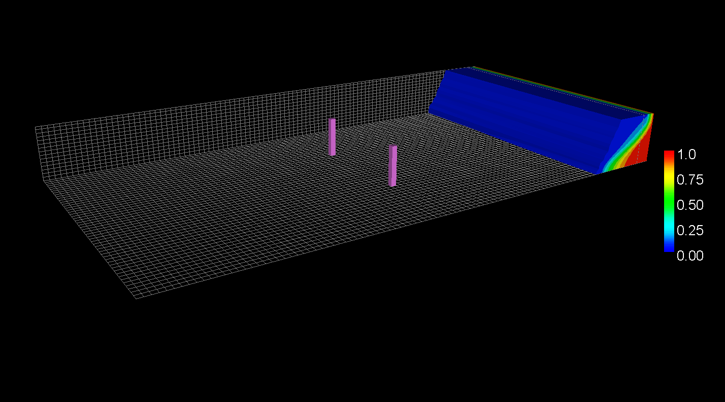
TVD Simulation Results

Slide 16
Calibration Procedure
Two calibration runs
Inverse concentration weighting
Uniform concentration weighting
Preferred value regularization (K = 200 m/d)
PEST with SVD-Assist

Slide 17
Calibration Results

Slide 18
Observation Well 11 Deep

Slide 19
Model Layer 5
UNIFORM WEIGHTING
1/C WEIGHTING
Log₁₀ K

Slide 20
Model Layer 5—10 years
UNIFORM WEIGHTING
1/C WEIGHTING
Log₁₀ K
Blue line – FD
Black line – TVD

Slide 21
Model Layer 5—20 years
UNIFORM WEIGHTING
1/C WEIGHTING
Log₁₀ K
Blue line – FD
Black line – TVD

Slide 22
Model Layer 15
UNIFORM WEIGHTING
1/C WEIGHTING
Log₁₀ K

Slide 23
Model Layer 15—10 years
UNIFORM WEIGHTING
1/C WEIGHTING
Log₁₀ K
Blue line – FD
Black line – TVD

Slide 24
Model Layer 15—20 years
UNIFORM WEIGHTING
1/C WEIGHTING
Log₁₀ K
Blue line – FD
Black line – TVD

Slide 25
Section along PW-1
UNIFORM WEIGHTING
1/C WEIGHTING
Blue line – FD
Black line – TVD

Slide 26
Prediction: Pumped Concentration

Slide 27
Prediction: Pumped Concentration

Slide 28
Conclusions
Numerical dispersion can be an important source of structural noise in calibration of transport models
Consequences
Formation of heterogeneity artifacts (low K at interface; high K at outflow location)
Reduced predictive capabilities
Mitigation strategies
Fine transport grids and/or TVD
Clever use of weighting and observations

Slide 29
Estimated K Field (FD)

Slide 30
Estimated K Field (TVD)

